Slide 1
5
Human Aggression and Violence

Slide 2
Chapter Objectives
Explore the various ways of defining and identifying aggressive behavior.
Review the major theories on the development of aggression and violence.
Emphasize the importance of cognitive processes in aggressive behavior.

Slide 3
Chapter Objectives
Explore the interactions of biology and cognitive processes in aggressive behavior and violence.
Outline important key concepts in understanding aggression and violence, such as weapons effect, modeling, and hostile attribution bias.

Slide 4
Chapter Objectives
Introduce the General Aggression Model and I³ Theory.
Review the effects of digital, electronic, and other media on aggression and violence.
Examine the current research on copycat (contagion effect) crime.

Slide 5
Defining Aggression
Social definition
The intent and attempt to harm another individual, physically or socially, or, in some cases, to destroy an object
Passive-aggressive behaviors
Still aggression
Not all aggressive behavior is socially negative
Sports
Some aspects of law enforcement
Varies by culture
Also by gender within a culture

Slide 6
Defining Aggression
Some criminal aggressive acts do not involve violence
Stalking
Threats
Some aggressive acts that are socially unacceptable are still not criminal acts
Predatory business practices
May intend to try to destroy competitor through legal, though often unethical, methods
Malicious internet posts
Kids bad behavior on playgrounds
Exclusion
Name calling
Others?????????

Slide 7
Defining Aggression
Hostile aggression
Expressive aggression
Response to anger-inducing conditions
Fight or flight (chose fight)
Goal is to make victim suffer
Torture homicide
Most violent crimes
More often than not it is not preplanned
May be situational
Violent only when drinking

Slide 8
Defining Aggression
Instrumental aggression
Aggression is a means to an end
Competition or the desire for some object ($) or status possessed by another person
Typically, no intent to harm unless interference
Robberies
May be preplanned

Slide 9
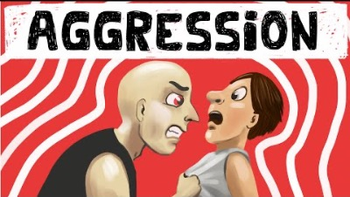
Theoretical Perspectives on Aggression (6:08)

Slide 10
Theoretical Perspectives on Aggression
Psychodynamic
Hydraulic model
Pressure builds up in a container…Boom!
Humans are prone to aggression by nature.
Freud: If violent crime is to be controlled, the human animal must be provided with multiple, but appropriate, channels for catharsis.
Channels include
Playing high energy sports
Also hypothesized that watching high energy sports could be an outlet as well (vicarious outlet)

Slide 11
Theoretical Perspectives on Aggression
Ethological viewpoints
Territory violations lead to violence
Based on studies of animals in the wild
Little empirical support
Too much reliance on instinct over cognition

Slide 12
Theoretical Perspectives on Aggression
Frustration-aggression hypothesis
The person is blocked from obtaining an expected goal.
Frustration results, generating anger
But all persons who experience frustration do not get angry
Anger predisposes or readies the person to behave aggressively.
While true in some cases, too simplistic an explanation for all aggression

Slide 13
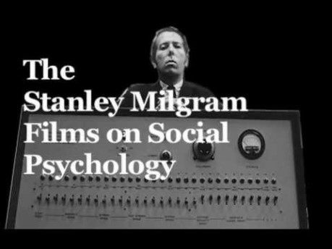
Theoretical Perspectives on Aggression: Frustration

Slide 14
Theoretical Perspectives on Aggression
Weapons effect
Berkowitz and LePage Study (1967) replicated by others since
Does the mere presence of a weapon cause those without one to act violently?
Some support for this
Does this mean we should pull all SRO’s out of public high schools?
Should we follow Great Britain a disarm all police officers?
Is there a weaponless effect?

Slide 15
Theoretical Perspectives on Aggression
Cognitive-neoassociation model
An aversive event produces a negative affect.
Physical pain or psychological discomfort
The unpleasant feeling may evoke aggressive or violent responses.
Cognitions mediate and evaluate a proper course of action which may or may not include aggression.
Really all this says is that in most circumstances, most of us think before we act

Slide 16
Theoretical Perspectives on Aggression
Displaced aggression theory
Angry in a situation where you cannot respond i.e. boss yells at you at work
Can’t take it out on the boss, go home and kick the dog for barking at the mailman (assume this is not the normal response)
This may be applicable in a number of domestic cases

Slide 17

Bandura on Social Learning Factors in Aggression and Violence (5:04)

Slide 18
Social Learning Factors in Aggression and Violence
Video Previous slide.
Would they do the same with a real person?
Or did they just learn it was ok to hit THIS doll?
Modeling
Bandura's Bobo doll experiment
Aggressive behavior is a reflection of aggression learned from role models
Three types of models
Family members (parents strongest factor)
One's subculture (gangs etc. Stronger factor than family for adolescents)

Slide 19
Social Learning Factors in Aggression and Violence
3. Symbolic Figures in Mass Media
Video Games
Does anyone really “die” in a video game?
Just hit the reset button
Movie Heroes
Movies
Violent X rated videos on the internet
(more on this upcoming)

Slide 20
Social Learning Factors in Aggression and Violence
Observation modeling (Bobo)
Individuals differ widely in their ability to learn from observation.
The motivation to rehearse what has been observed (value of role model)
What happens to the observed model
Are they rewarded or punished
Periodic reinforcement is essential to maintain behavior.

Slide 21
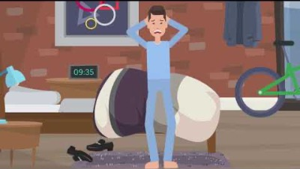
Cognitive Models of Aggression (2:08)

Slide 22
Cognitive Models of Aggression
Hostile attribution model
Youth and adults prone toward violence are more likely to interpret ambiguous actions as hostile and threatening than are their less aggressive counterparts.
Attribution error is always external, toward others, not toward self
Develops during preschool years.
Peer rejection
Abuse and maltreatment
Attribution error common in domestic violence

Slide 23
Cognitive Models of Aggression
Aggressive behavior
Aggressive behavior often receives immediate reinforcement for the aggressor, good or bad
Becomes persistent strategy
Diminished intellectual competence
Poor social skills
Aggression is the easiest response
Not much cognitive load imposed

Slide 24
Cognitive Models of Aggression
The general aggression model
Aggression and violence depends on:
How an individual perceives and interprets the social environment
Expectations about the likelihood of various outcomes

Slide 25
Cognitive Models of Aggression
The general aggression model
Aggression and violence depends on:
Knowledge and beliefs about how people important to them usually respond in similar situations
The cognitive and other “tools” the person has
Is a knee jerk violent response all they have? No other “good” social skills?

Slide 26
Cognitive Models of Aggression
5. Other external influencers
Who else is present that might influence the response?
-Deviant peers
-Others around that expect a violent reaction. Is the person the bully and the rest of the class is watching so reputations are at stake
Are factors present that impair cognition: Drugs and Alcohol

Slide 27
Overt and Covert Acts of Aggression
Gender differences in aggression
Differences due to cultural and socialization processes
Gender differences in aggressive behavior emerge in preschool years.
Girls engage in relationship and interpersonal forms of aggression.
Play with dolls
Boys engage in physical aggression.
Play violent video games
Contact sports
Parents and significant others in the child’s life treat each gender differently with respect to acceptable aggressive behaviors

Slide 28

Caregiver Expectations By Gender (3:25)

Slide 29
Effects of Media Violence
The research community is sharply divided whether or not violent media and violent video games are linked with aggressive/violent behavior on the part of the user/viewer
Video games have an interactive component, other forms of media do not.
This has been shown to enhance learning in general because it is interactive but whether or not this is related to user violence outside of the game is not well understood
MAY have a significant effect on those persons ALREADY predisposed toward violent behavior
But it is only one risk factor

Slide 30
Effects of Media Violence
Is it likely that persons spending inordinate amounts of time playing video games do so because they are already social outcasts?
If so, is it the social isolation and a lack of socially accepted peers on the part of extreme players driving the violence and not the video games
Does the role assumed in the game make a difference: Good guy vs bad guy?
Or does the game become so addictive they spend all of their time alone playing the games and become social outcasts because of this?

Slide 31
Effects of Media Violence
Watching violent movies and playing violent video games may not increase the tendency toward acting violently in persons not already predisposed toward acting that way
Does it matter if the person always loses or always wins?
Short-term and long-term effects may not be the same
In general, most persons that watch violent movies and play violent video games are not any more aggressive or violent than persons not involved with either of these forms of entertainment

Slide 32

Effects of Media Violence (5:40)

Slide 33
Effects of Media Violence
Copycat effect
Contagion effect
Tendency to model or copy an activity portrayed in the media
School-shooter copycats
Copycat terrorists

Slide 34
Additional Resources
Videos:
Theories of Aggression in Social Psychology. (2021) Practical Psychology https://www.youtube.com/watch?v=SNWW-pPmTsI
Stanley Milgram: Human Aggression (2012) https://www.youtube.com/watch?v=nHSonimgv68
Albert Bandura's Bobo Doll experiment (2015) PsycHub https://www.youtube.com/watch?v=dDA5nmiGD2w
Attribution Bias. (2019) WildDigiCare https://www.youtube.com/watch?v=f2TbR3_Imnc
Girl Toys vs Boy Toys (2017) BBC https://www.youtube.com/watch?v=nWu44AqF0iI
Are Violent Video Games Bad for You? (2017) PsyShow Psyc. https://www.youtube.com/watch?v=qwv_wTUNwLs

